Slide 1
WEB SERVER BASED
HOME AUTOMATION USING
INTERNET OF THINGS
WEB SERVER BASED
HOME AUTOMATION USING
INTERNET OF THINGS

Slide 2
INTRODUCTION
INTRODUCTION
What is Home Automation?
Wireless Home Automation system(WHAS) using IoT is a system that uses computers or mobile devices to control basic home functions and features automatically through internet from anywhere around the world.
What is Our Moto?
It is meant to save the electric power and human energy.
Easy Installation And Reduced Installation Costs.
Integration of mobile devices.

Slide 3
What is the Purpose of this Project?
The proposed home automation system can control the following appliance:
Lights on/off
Fan on/off
Regulate the appliances.
On/off different appliances.
Detect weather the appliances are on/off.

Slide 4
OUR PROJECT
OUR PROJECT

Slide 5

FLOW OF HOME AUTOMATION
FLOW OF HOME AUTOMATION
USER
CLOUD
INTERNET
ROUTER
RELAY
LOAD 1
RELAY
LOAD 2
[ESP-32 WROOM 32]
RELAY
LOAD 3
CODE
RELAY
LOAD 4
POWER
RELAY
LOAD 5

Slide 6
OUR PROGRESS TILL 24/02/2021
OUR PROGRESS TILL 24/02/2021

Slide 7
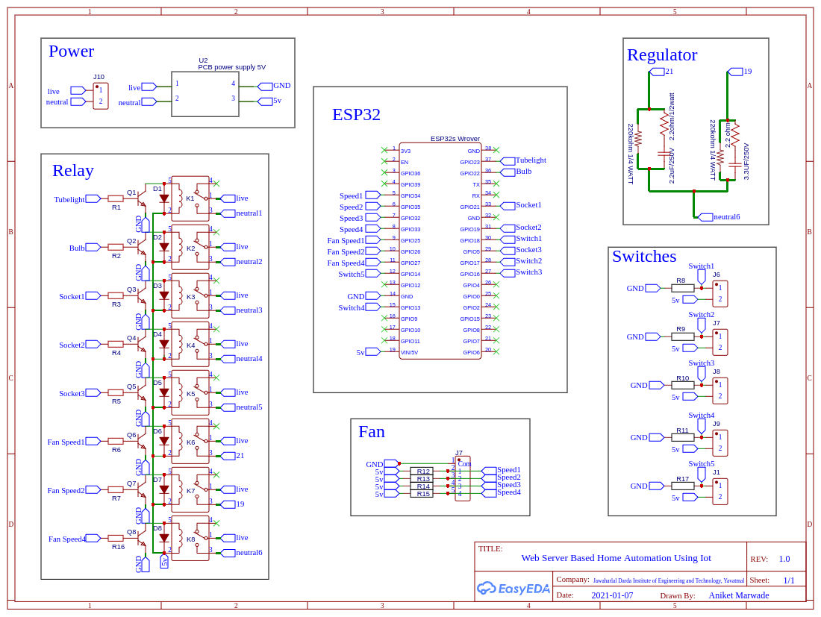
CIRCUIT
DIAGRAM
CIRCUIT
DIAGRAM

Slide 8
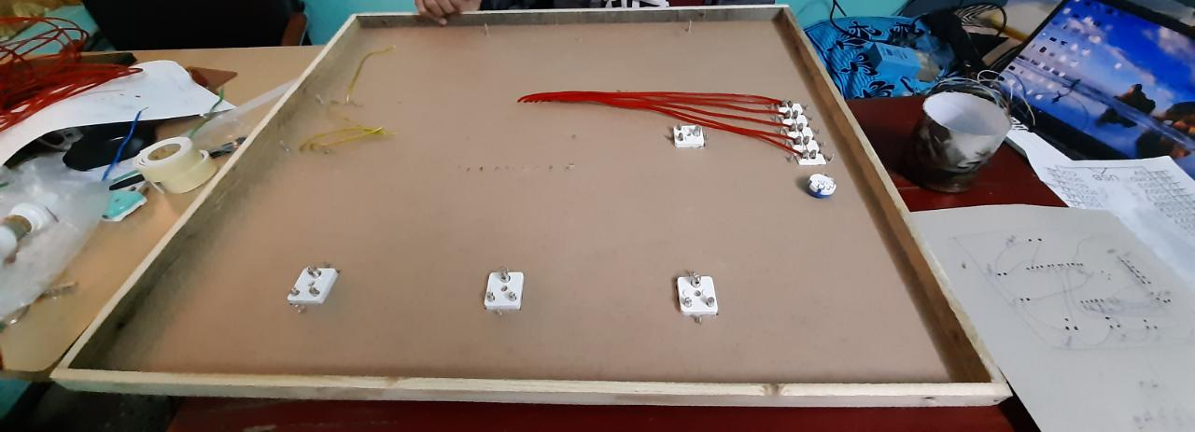
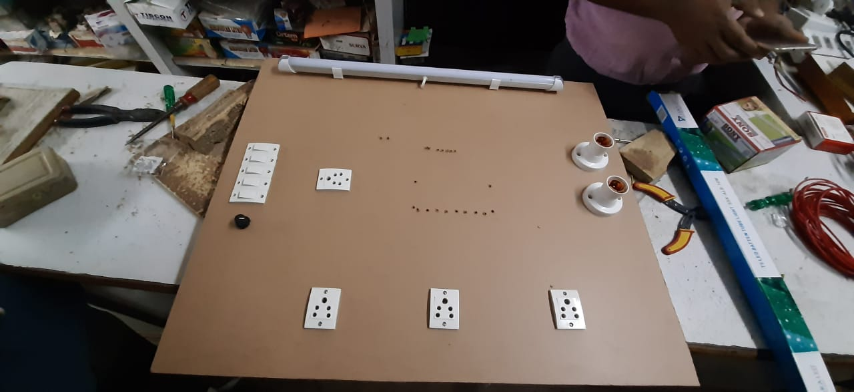
MAIN BOARD
MAIN BOARD
BACK SIDE
FRONT SIDE

Slide 9
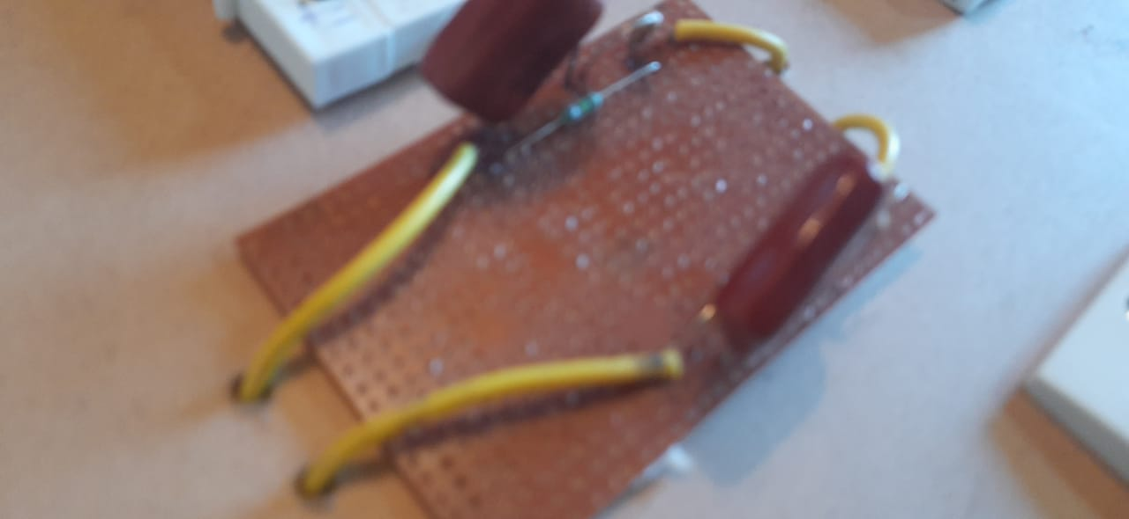
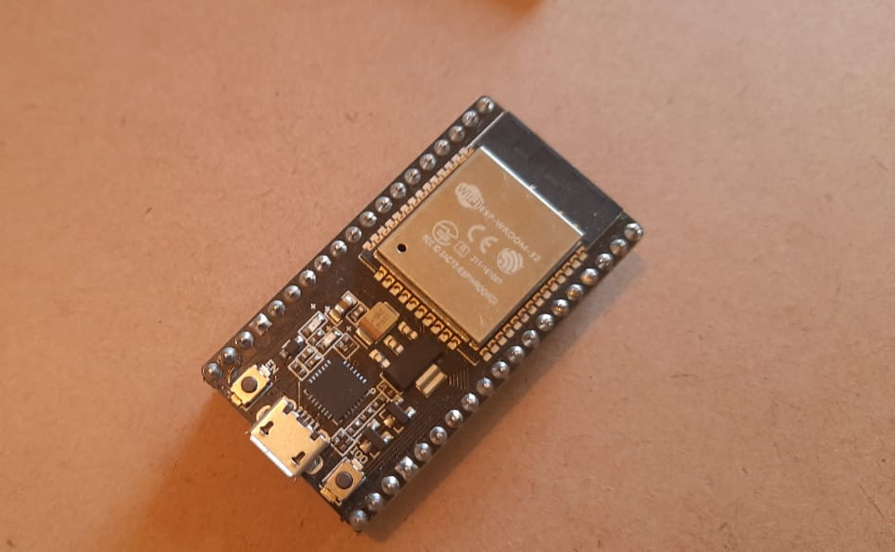
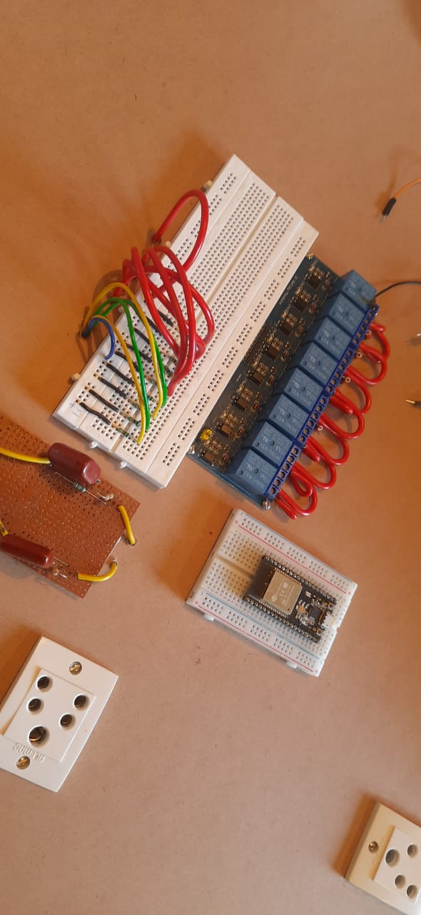
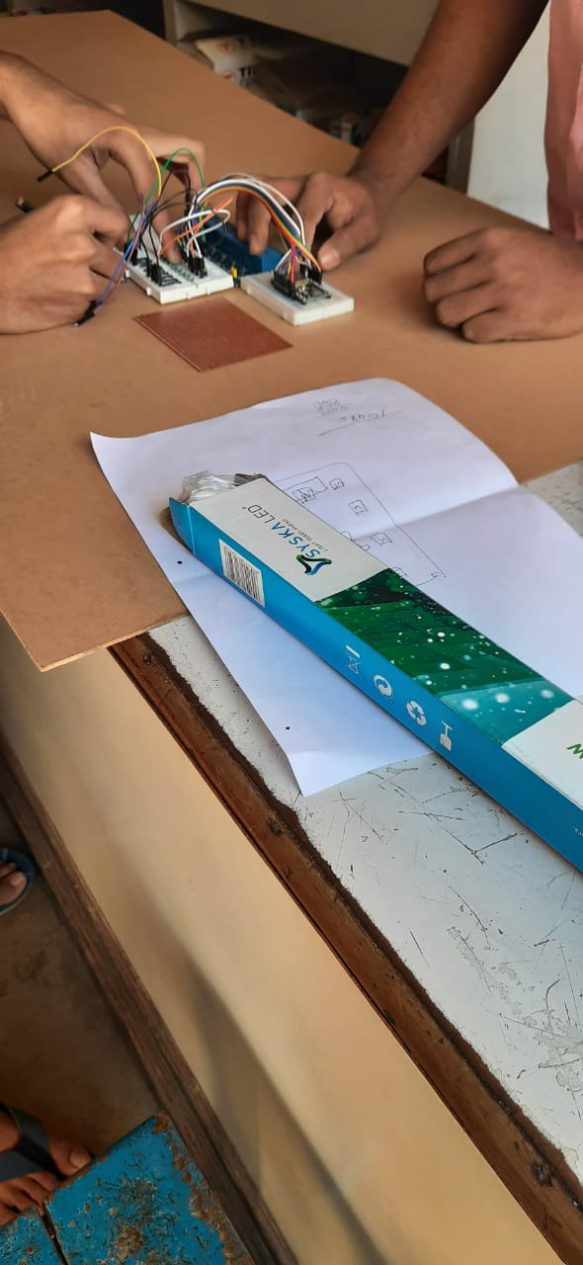
OTHER COMPONENTS OF THE BOARD

Slide 10
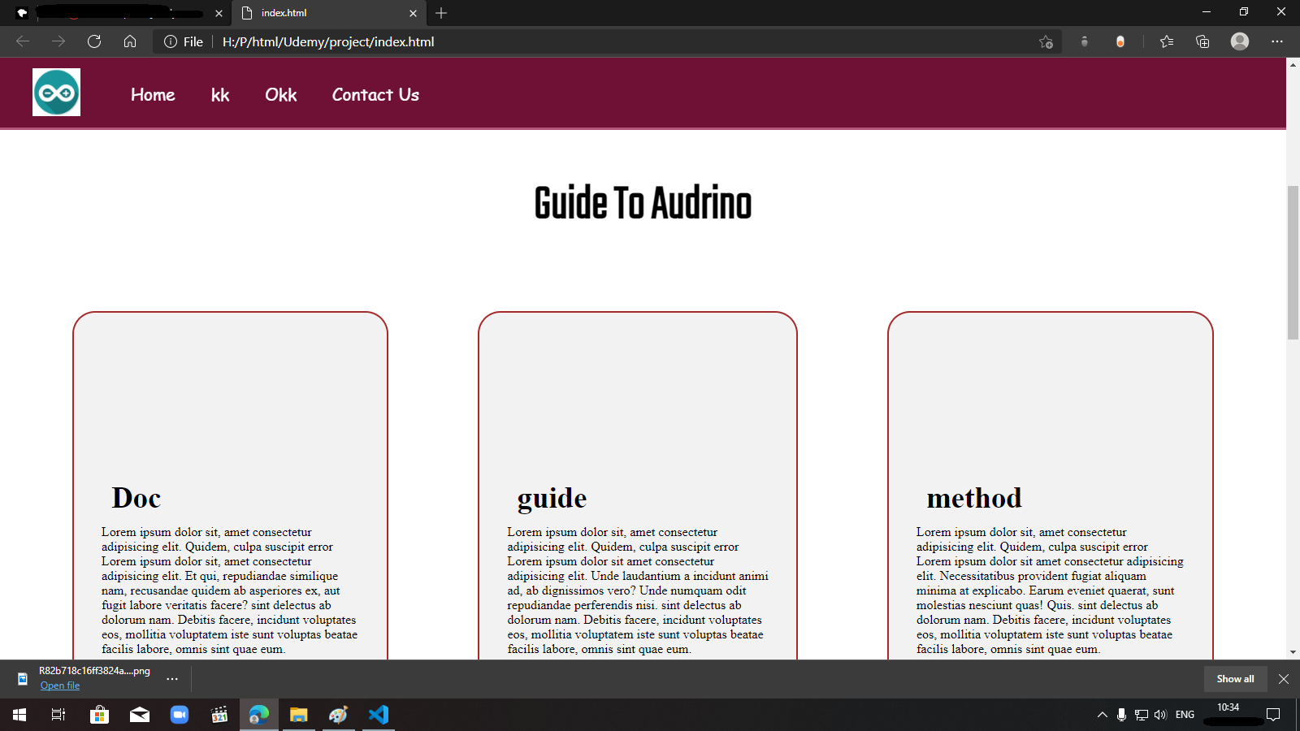
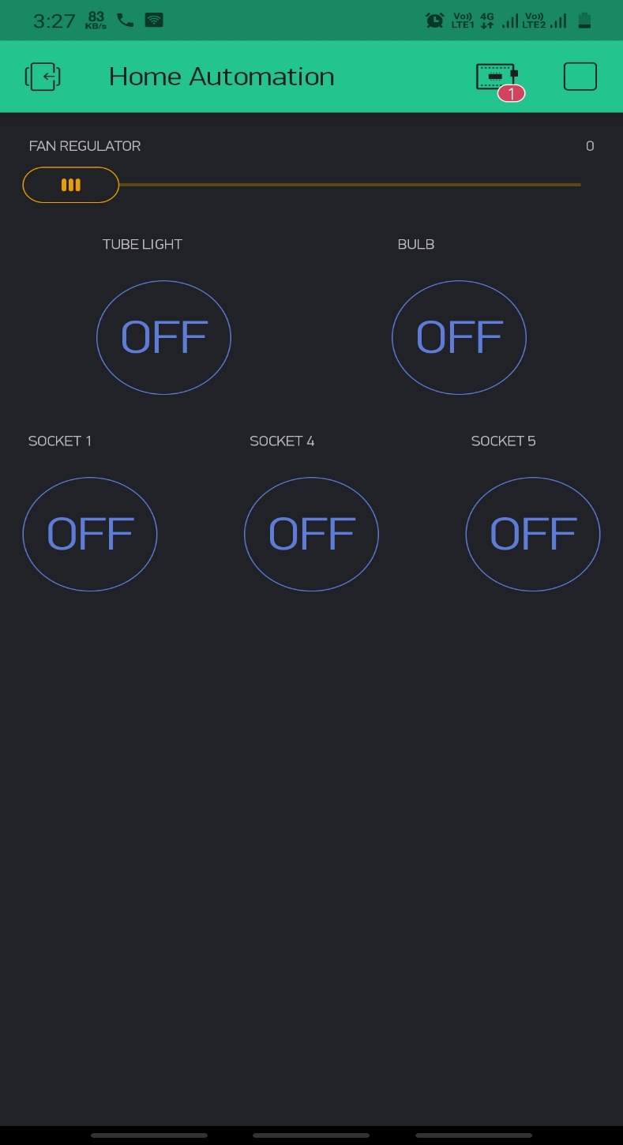
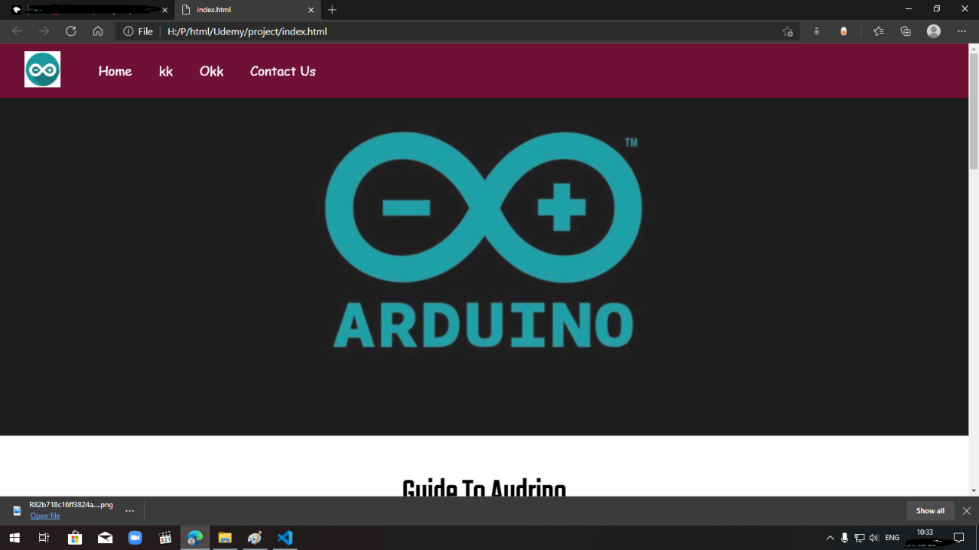
APP AND WEBSITE USER INTERFACE
APP AND WEBSITE USER INTERFACE

Slide 11
SAMPLE CODE
CLOUD CONNECTIVITY
FOR CONTROLLING FAN
// Fan Speed Control
void speed0()
{
//All Relays Off - Fan at speed 0
if (DEBUG_SW)Serial.println("SPEED 0");
digitalWrite(Speed1, HIGH);
digitalWrite(Speed2, HIGH);
digitalWrite(Speed4, HIGH);
}
//Blynk Cloud Authentication token
char auth[] =
"1KI9pZktz5A9kTT3d7c0QslmIjowKmW0";
// Your WiFi credentials.
// Set password to "" for open networks.
char ssid[] = "Error";
char pass[] = "123456789";

Slide 12
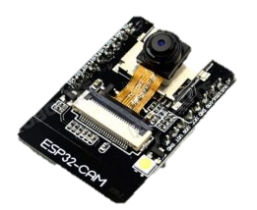
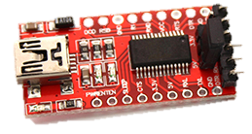
ESP 32 CAM
TTL CONNECTOR

Slide 13
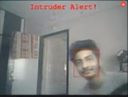
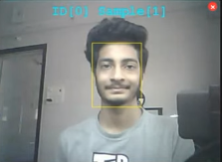
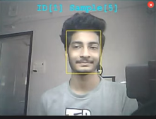
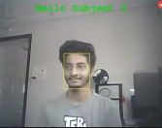

Slide 14
Thank you

